Slide 1
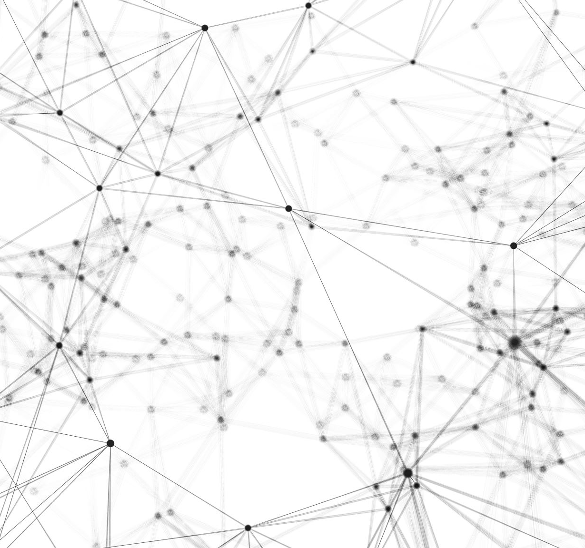
Segmentation and Classification of Melanoma
Vivek Verma
Committee Members:
Dr. Sebastien Motsch
Dr. Spring Berman
Dr. Houlong Zhuang

Slide 2
OUTLINE OF THE THESIS
Introduction
Goal
Segmentation
Classification + Segmentation
Future Work

Slide 3
INTRODUCTION
Melanoma is a dangerous form of skin cancer and can spread to different parts of the body if left untreated. The sensitivity of clinical diagnosis of melanoma with an unaided eye is only about 60%.
Development in the field of Deep learning/Computer vision has evolved it into a powerful tool. It can outperform humans in areas such as detection, classification in digital images with less than 5% error, therefore it can be an asset for pathologists to increase their effectiveness and accuracy.
Dermoscopy helps in enhancing the visual features of the skin lesions and aids in detection. Nonetheless, the task of detection using deep learning poses great challenges.
The contribution of this thesis can be summarized as follows:
Diving into segmentation architecture to find out region of interests, i.e., mole and doing a comprehensive analysis of the network.
Classification of the mole into Nevus(Non-Cancerous) and Melanoma(Cancerous) using a pre-trained model and fine-tuning its parameters which better suit our problem statement/data-set.

Slide 4
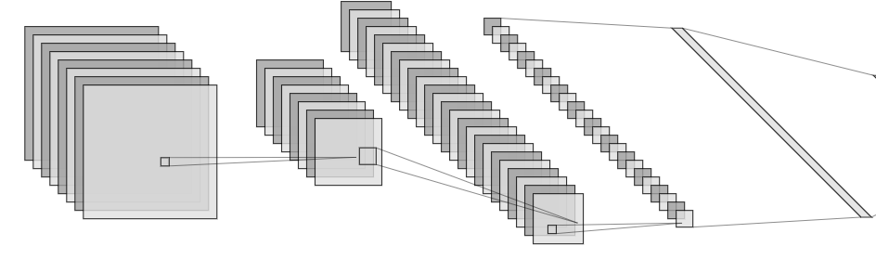
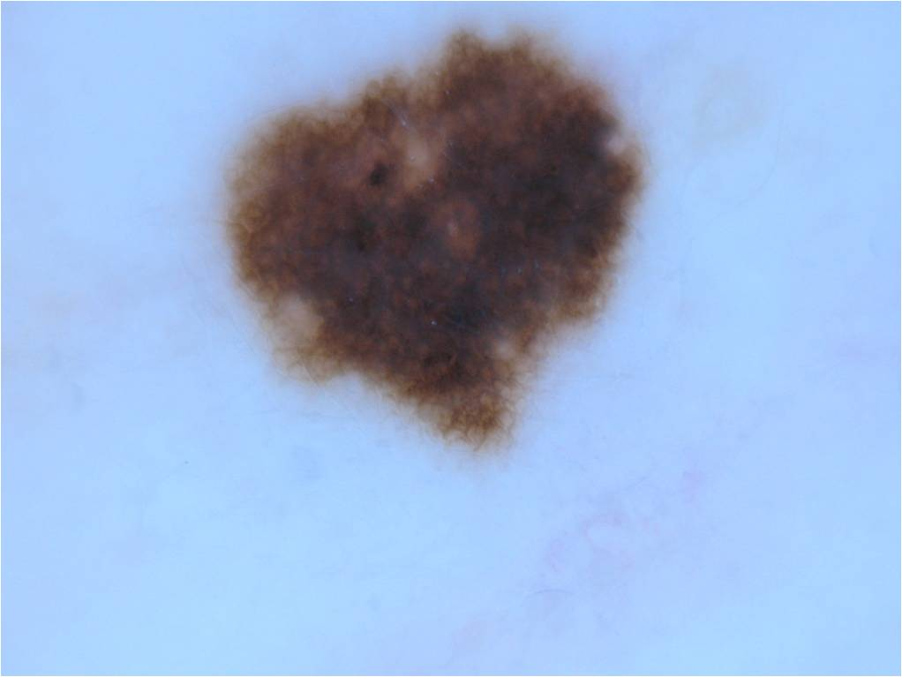
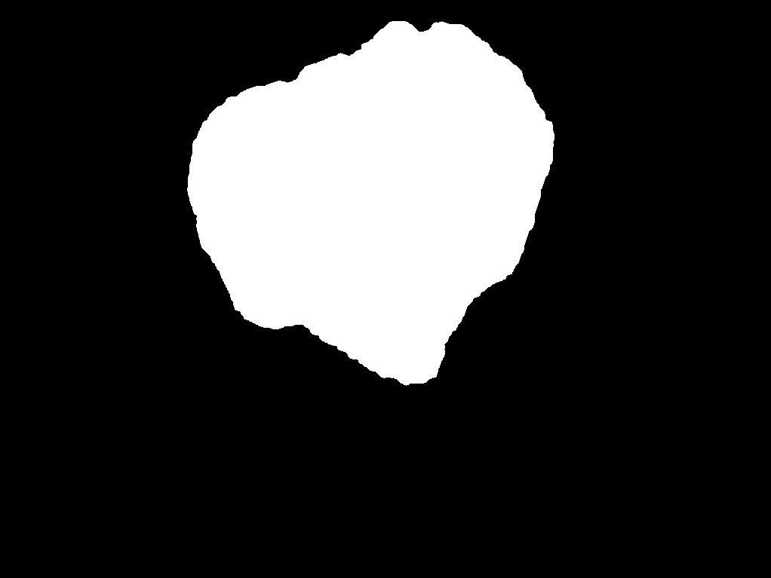
Goal
The goal of this thesis is to integrate segmentation into classification of images into Nevus and Melanoma to better the results.
First: A segmentation machine learning model is trained.
Second: A classification model was trained separately first to see the results and have a baseline score.
Third: Segmentation data was included into the classification architecture. Different methods were experimented with to see which one yields good results.
Nevus
3) Melanoma
1) Segmentation 2) Classification
Figure 1: Goal Thesis

Slide 5
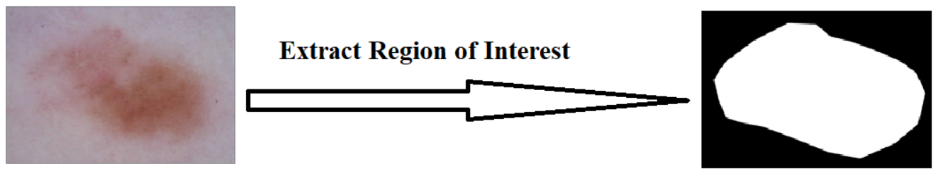
Segmentation
Figure 2: Region of Interest Extraction with Segmentation
Image Segmentation is one of the key topics in the field of image processing/computer vision and plays a crucial role in areas such as medical image analysis, perception in robots and much more.
Segmentation divides visual input into segments in to order to simplify analysis and only the regions of interests are passed on further for processing. It basically clusters pixels belonging to same class together.
Segmentation algorithm was used to extract the region of mole from a given image and remove the background (skin). ISIC-2018 data set for training the models, it contains 2594 images and masks.
Mask is the ground truth of the input image. It contains pixel level information of which pixel has a class ‘mole’ and ‘not a mole’, i.e., skin. In numerical terms it has values of 1 and 0.

Slide 6
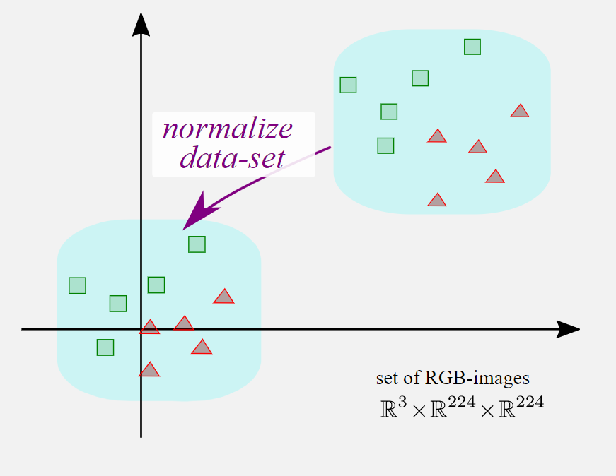
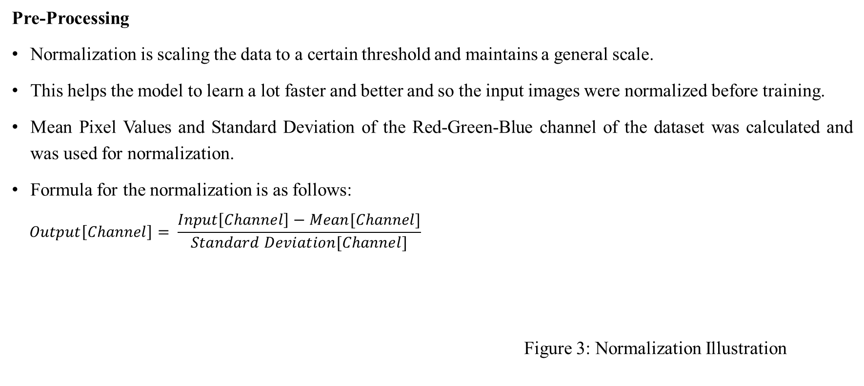
Segmentation
Pre-Processing
Normalization is scaling the data to a certain threshold and maintains a general scale.
This helps the model to learn a lot faster and better and so the input images were normalized before training.
Mean Pixel Values and Standard Deviation of the Red-Green-Blue channel of the dataset was calculated and was used for normalization.
Formula for the normalization is as follows:
$$Output\left[Channel\right]= \frac{Input\left[Channel\right]−Mean[Channel]}{Standard Deviation[Channel]}$$
Figure 3: Normalization Illustration

Slide 7
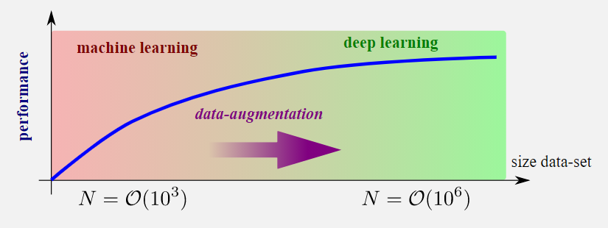
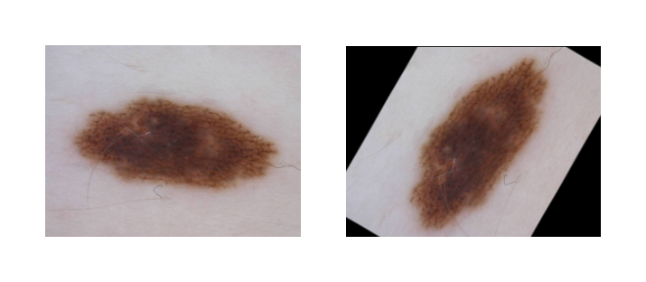
Segmentation
Data Augmentation
Data Augmentation is a set of techniques used to increase the amount of data available by adding moderately modified duplicate of data or create synthetic data newly from existing data.
It adds more data to limited data and prevents overfitting.
Horizontal flipping: Columns of the input image is reversed.
Rotation: Rotates the image between -180º and 180º.
Resized crop: A Random subset is created from the original
image and scaled back to a given size. Figure 4: Performance Increase with data
The same spatial augmentations are applied to mask
as well to keep the orientation of image-mask same.
Figure 5: Example of Data Augmentation

Slide 8
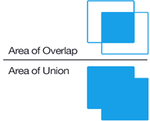
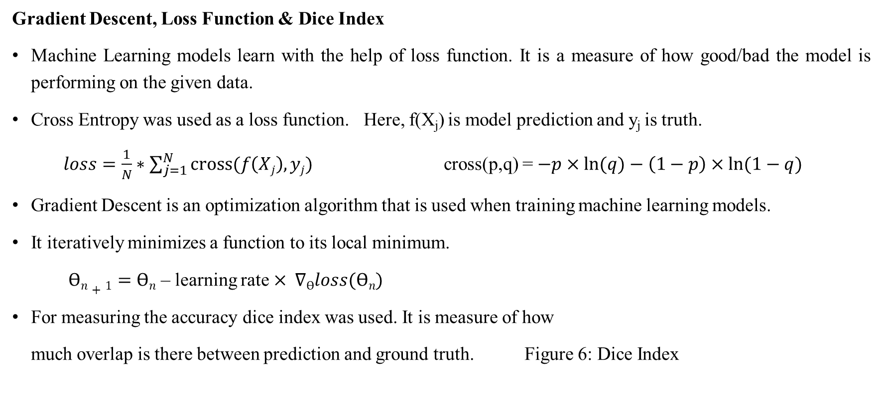
Segmentation
Gradient Descent, Loss Function & Dice Index
Machine Learning models learn with the help of loss function. It is a measure of how good/bad the model is performing on the given data.
Cross Entropy was used as a loss function. Here, f(X_{j}) is model prediction and y_{j} is truth.
$loss=\frac{1}{N}∗\sum_{j=1}^{N}{cross(f\left(Xj\right),yj) }$ cross(p,q) = $−p×ln⁡(q)−\left(1−p\right)×ln⁡(1−q)$
Gradient Descent is an optimization algorithm that is used when training machine learning models.
It iteratively minimizes a function to its local minimum.
$Ѳn+1=Ѳn$ – learning rate $× ∇Ѳloss(Ѳn)$
For measuring the accuracy dice index was used. It is measure of how
much overlap is there between prediction and ground truth. Figure 6: Dice Index

Slide 9
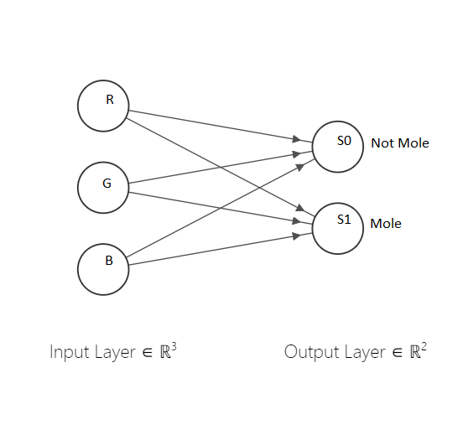
Segmentation
Architecture & Results – “Level 0”
This architecture is the most basic one aimed at experimenting at how a model with as low as mere 8 parameters would perform at such a complex task of semantic segmentation. The r-g-b values from the image serves as the input for the two nodes. The two nodes or neurons are responsible for giving out scores for the input pixel being skin and mole respectively, i.e., the model outputs a two-channel feature map of the scores given to pixels from the input image. Visual representation of the architecture is as follows.
Figure 7: Level 0 Architecture

Slide 10
Segmentation
Architecture & Results – “Level 0”
The train-test split was kept as 90-10%.
Learning rate was kept at 10⁻³.
Batch size of 2 was used and the model was trained for 25 epochs.
Adam was used as the optimizer and CE(Cross Entropy) loss as the loss function(Supervision).
The model was quick to learn to its maximum limit and 3 epochs were enough for the model to learn. After that negligible changes could be seen in training and testing curves.
The average dice achieved in the test was approximately 0.58.
The results show that 8 parameters do not serve the purpose of accurate segmentation. The predictions are not good and would lead in poor segmentation with a lot of misclassifications.

Slide 11
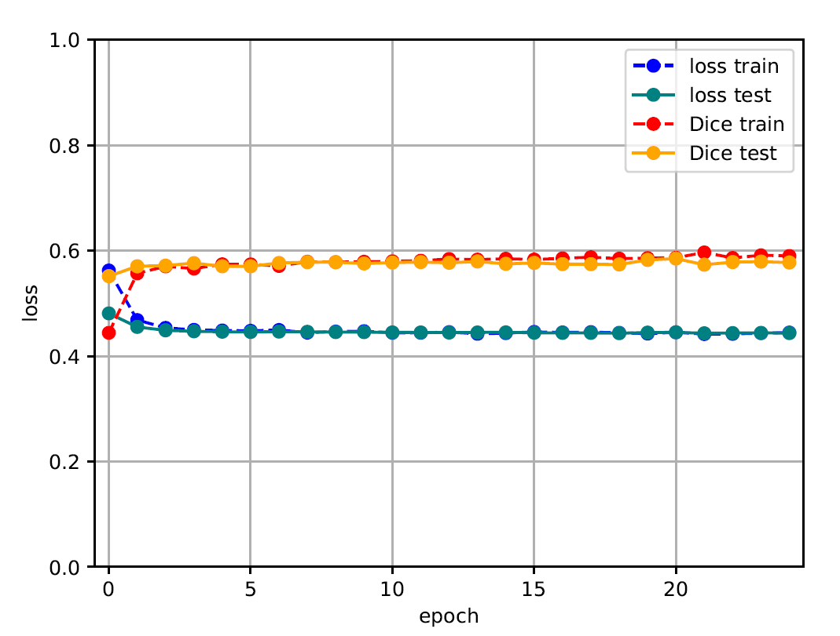
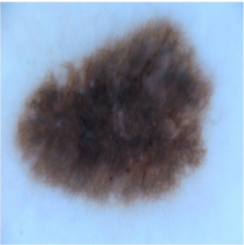
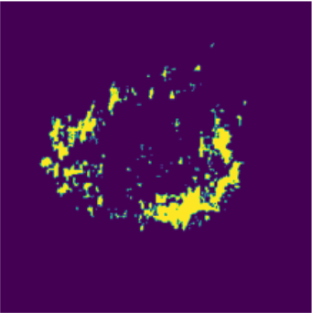
Segmentation
Architecture & Results – “Level 0”
Training result can be found in Figure 2.
Figure 9: Level 0 Segmentation
Figure 8: Training Result

Slide 12
Segmentation
Architecture & Results – U Net
U-Net was specifically designed for the purpose of Image segmentation in the field of biomedical.
It consists of two paths. The first path is contraction path (also called encoder) and is used to capture the features of the input images. Encoder contains convolution and max pooling layers.
The second path is an expansion path symmetric to the encoder, called as a decoder. Decoder contains transposed convolution layers needed to up sample the image and convolution layers to keep extracting features.
This architecture leverages the power of skip connections at 4 different channel levels. Essentially, skip connections are connections from layers earlier in the architecture to the layers that come later via addition or concatenation.
This is an end-to-end fully convolution network and does not contain linear layers, hence it can accept images of any size.

Slide 13
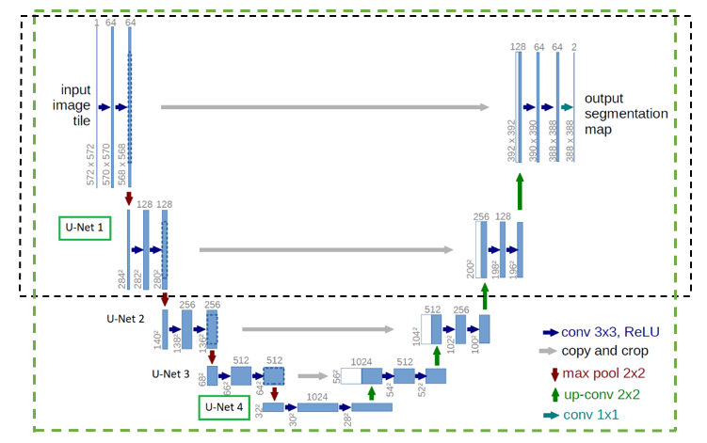
Segmentation
Architecture & Results – U Net
U-Net architecture can be found in the Figure 8.
We explore various modifications in U-Net where we
reduce the complexity of the neural network to see its
effect and study the increase/decrease in performance
with change in number of parameters.
Figure 10: U Net Architecture

Slide 14
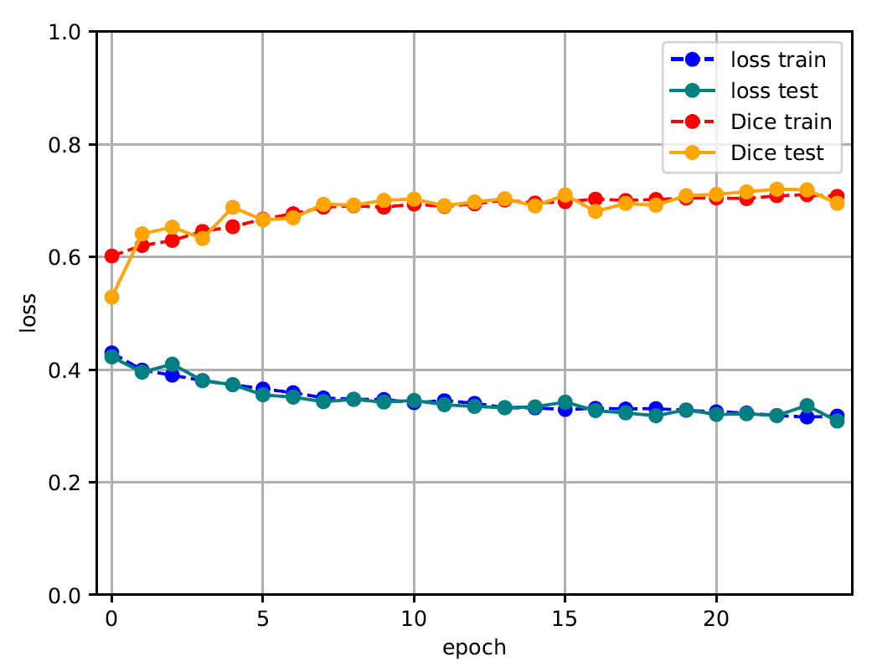
Segmentation
Architecture & Results – U Net
U-Net 1
This network has 403,842 number of parameters and is the smallest
out of all the U-Net variations.
For training this network a train-test split was kept as 60-40%.
Learning rate was kept at 10⁻⁴.
Batch size of 1 was used and the model was trained for 25 epochs.
Adam was used as the optimizer and CE as the loss function.
The model was able to attain a highest test dice index of about 0.72. Figure 11: U Net 1 Training Result

Slide 15
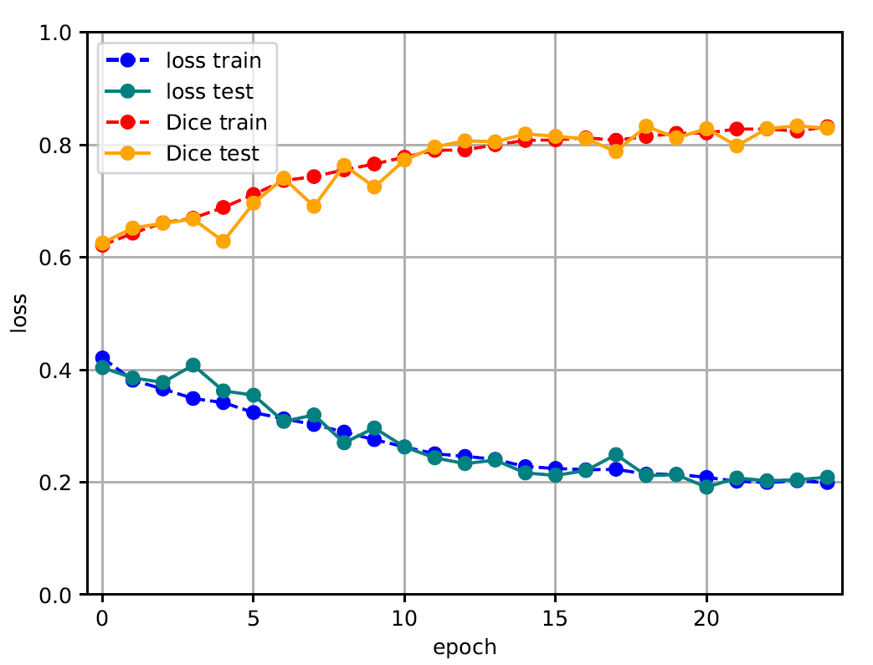
Segmentation
Architecture & Results – U Net
U-Net 4
This network has 31,031,810 number of parameters in it making it
quite heavy in terms of computation power.
For training this network a train-test split was kept as 90-10%.
Learning rate was kept at 10⁻⁴.
Batch size of 1 was used and the model was trained for 25 epochs.
Adam was used as the optimizer and CE as the loss function.
The model was able to attain a highest test dice index of 0.834. Figure 12: U Net 4 Training Result
The attained accuracy falls in the ‘good score’ range and the training results can be seen in Figure 10.

Slide 16
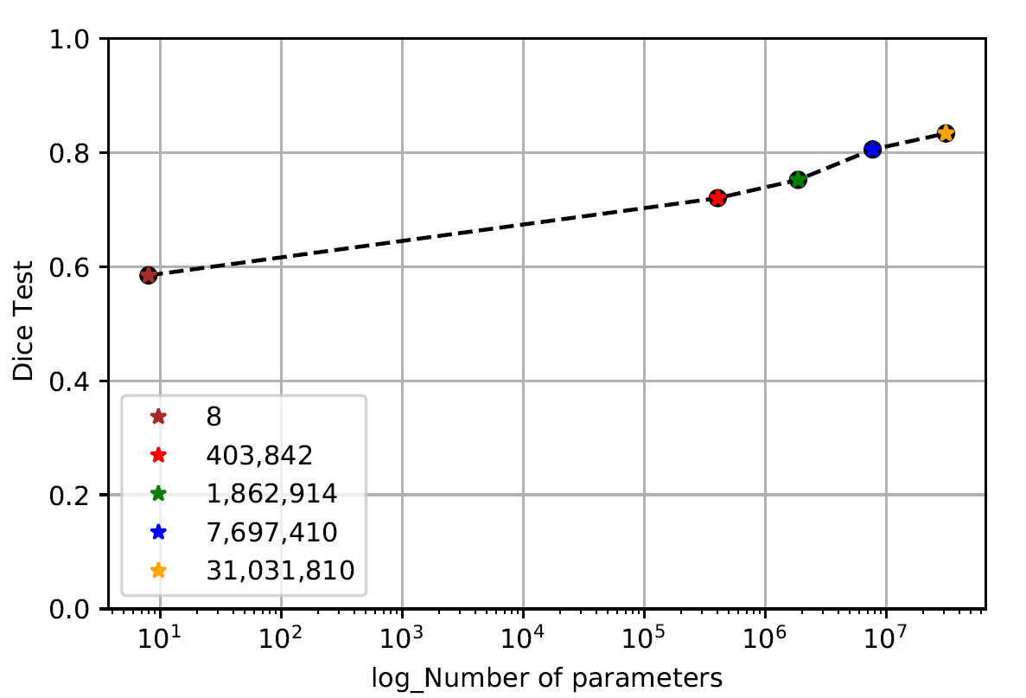
Segmentation
Performance vs. Number of Parameters
Parameters in a neural network architecture are the elements
which are learn able.
These are in general referred to as weights and biases that are
learnt during the training process.
Although it seems logical that the more complex the architecture
the results it produces is proportional.
But as per the experimental results we see that, as we increase the
parameters there is a rise in test dice index but only till a certain value Figure 13: Test Dice vs No. of Param
post which it starts to flatten out.

Slide 17
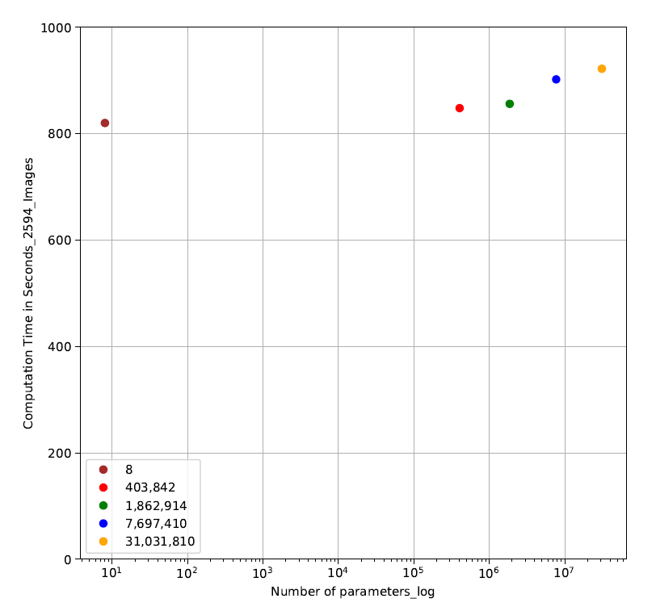
Segmentation
Computational Time
Knowing the computational complexity of a machine learning model
is very important.
It tells us how fast or slow is the model going to perform for an
input size.
All the models were run on the entire ISIC-2018 dataset.
Time taken by the 31,031,810 parameters to process the data is
922 seconds while for 8 parameters, it is 820 seconds
The increase in time taken from lowest to highest is only about
12.43%. Figure 14: Comp. Time vs No. Param(Log)

Slide 18
Segmentation
Conclusion
After evaluating the results, we decided to go with
U-Net 4 for integrating into the classification architecture.
Table of model stats can be found in Table 1.
Parameter | One Neuron Model | U-Net 1 | U-Net 2 | U-Net 3 | U-Net 4
Highest Test Dice Index | 0.58 | 0.72 | 0.75 | 0.80 | 0.83
Computational Time(seconds) | 820 | 848 | 856 | 902 | 922
Table 1: Model Stats

Slide 19
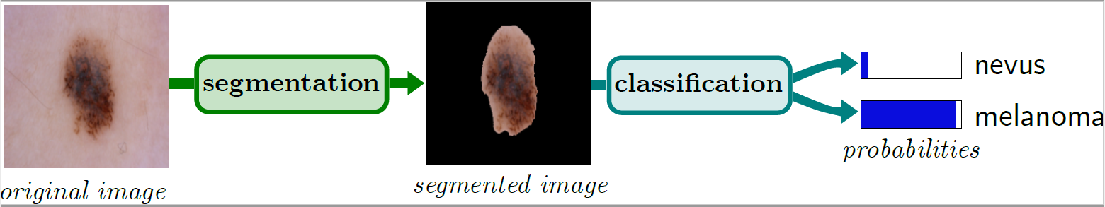
CLASSIFICATION
Classification is the task of predicting which class an item belongs to. Classifiers can be binary which results in a yes or no decision or are able to categorize items into several classes. Classification is used in machine learning areas such as email spam filtering, Image recognition etc. and much more.
Manual classification is generally subjective and greatly depends on the person accessing the situation. Therefore, a computer aided technology helps pathologists/dermatologists perform better.
A pre-trained model was used and fine-tuned as per the needs of the problem statement/data-set. This is also known as Transfer Learning. For this purpose, a combination of ISIC-2019 and 2020 data-set was used.
Figure 15: Overview of The Process

Slide 20
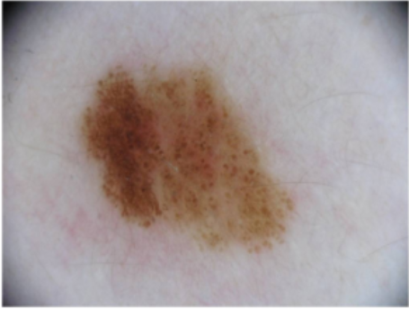
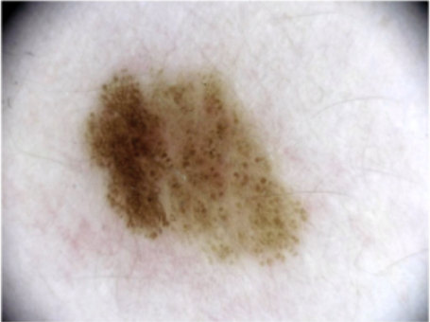
CLASSIFICATION
Pre-Processing & Data-Augmentation
This follows the same procedures from the segmentation network in which we normalized and augmented the data before training.
Horizontal flipping: Horizontal flip augmentation is when the columns of the input image is reversed.
Rotation: Rotation augmentation is done by rotating the image between -180º and 180º.
Resized crop: Resized crop augmentation is when a random subset is created from the original image and scaled back to a given size.
Color Jitter: In this augmentation rather than the location of pixels brightness, contrast and saturation are altered.
Color Jitter
Figure 16: Jitter Augmentation

Slide 21
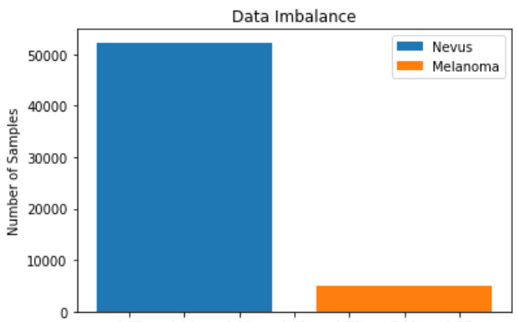
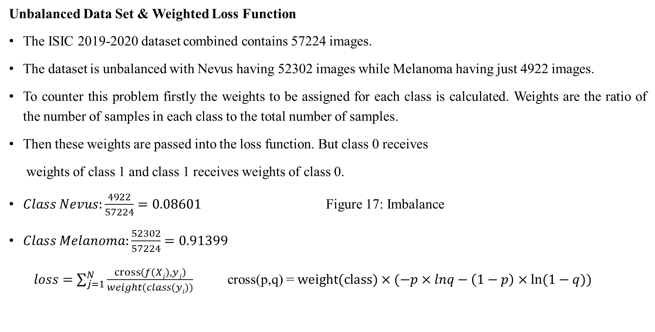
CLASSIFICATION
Unbalanced Data Set & Weighted Loss Function
The ISIC 2019-2020 dataset combined contains 57224 images.
The dataset is unbalanced with Nevus having 52302 images while Melanoma having just 4922 images.
To counter this problem firstly the weights to be assigned for each class is calculated. Weights are the ratio of the number of samples in each class to the total number of samples.
Then these weights are passed into the loss function. But class 0 receives
weights of class 1 and class 1 receives weights of class 0.
$Class Nevus:\frac{4922}{57224}=0.08601$ Figure 17: Imbalance
$Class Melanoma:\frac{52302}{57224}=0.91399$
$loss=\sum_{j=1}^{N}{\frac{cross\left(f\left(Xj\right),yj\right)}{weight(class(yi))} }$ cross(p,q) = $weight(class)×(−p×lnq−\left(1−p\right)×ln⁡(1−q))$

Slide 22
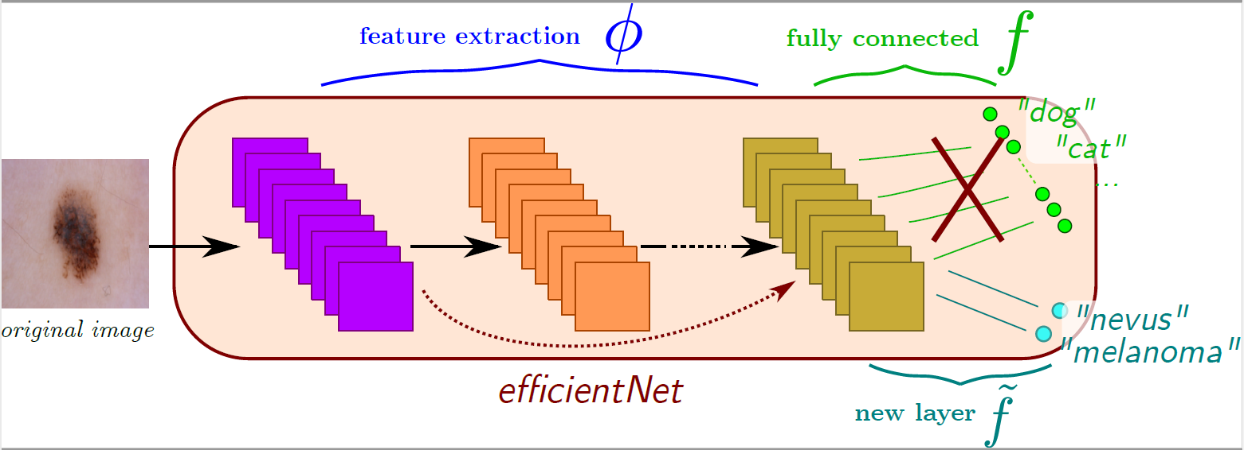
CLASSIFICATION
Architecture for Classification
Google in 2019 released the neural network architecture called as Efficient-Net making a new addition to the family of convolution neural networks. The model has variations from B0 to B7.
This network provided to be very useful since it had a smaller number of parameters but provided a very high classification accuracy.
We picked a pre-trained model of Efficient Net ‘B1’ architecture for the task of classification but fine tuned it as per the needs of our problem statement.
The weights were un-freezed during training,
and the classifier linear layers were replaced with
custom linear layers. This will be discussed in
later slides in detail.
Figure 18: Transfer Learning

Slide 23
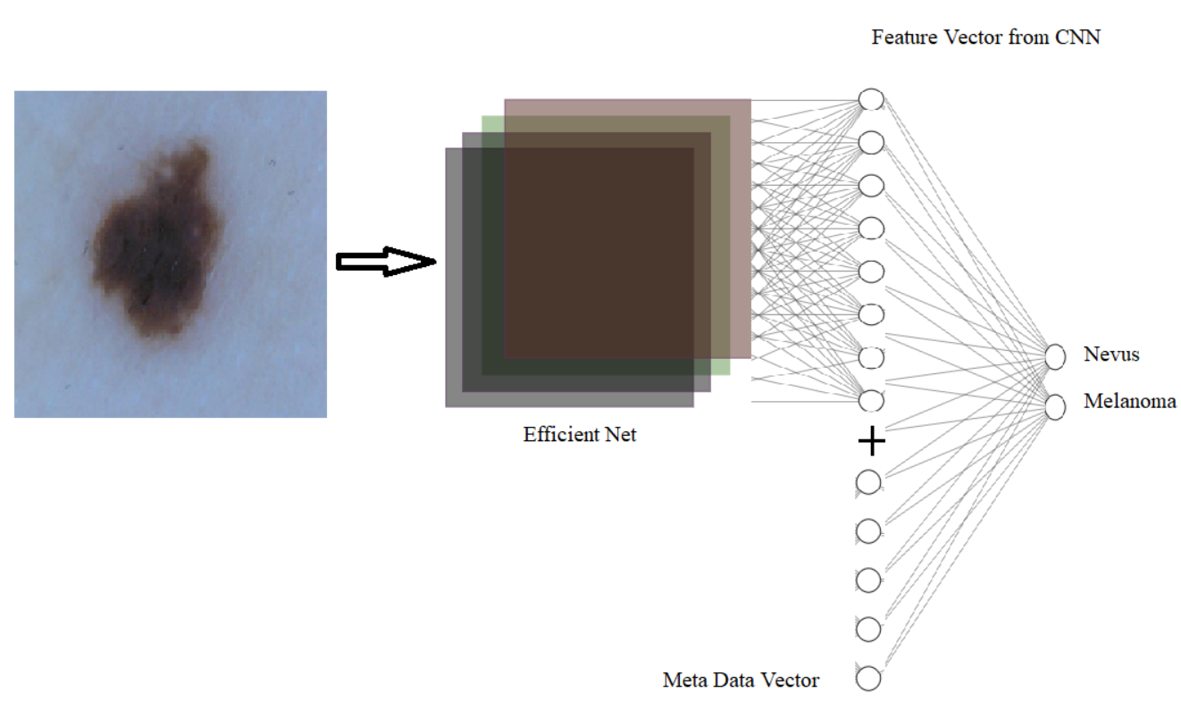
CLASSIFICATION
Architecture for Classification
Efficient Net B1 has 7,794,184 number of parameters in it.
It is a classification network with CNN and linear layers.
The CNN layers from the architecture output a feature vector
which is concatenated with the meta data vector.
Meta-data contains additional information about the data such
as Age, Gender, Location of the Mole.
Both the feature vectors are combined into a linear layer which
makes a 2-class output of the image being Nevus or Melanoma. Figure 19: CNN & Meta-data Fusion Illus.
The learning of the CNN and linear layers happens with a different learning rate.

Slide 24
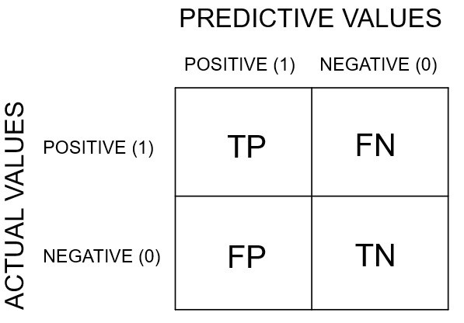
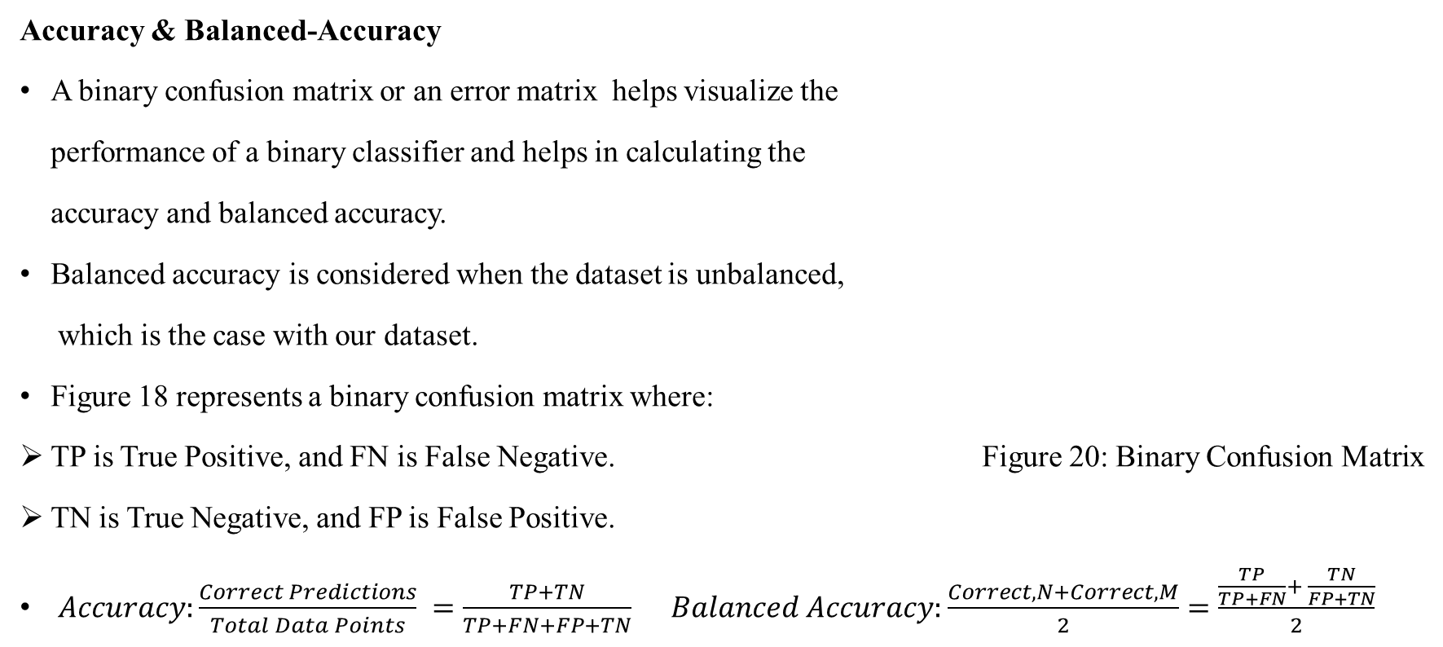
CLASSIFICATION
Accuracy & Balanced-Accuracy
A binary confusion matrix or an error matrix helps visualize the
performance of a binary classifier and helps in calculating the
accuracy and balanced accuracy.
Balanced accuracy is considered when the dataset is unbalanced,
which is the case with our dataset.
Figure 18 represents a binary confusion matrix where:
TP is True Positive, and FN is False Negative. Figure 20: Binary Confusion Matrix
TN is True Negative, and FP is False Positive.
$Accuracy:\frac{Correct Predictions}{Total Data Points} =\frac{TP+TN}{TP+FN+FP+TN}$ $Balanced Accuracy:\frac{Correct,N+Correct,M}{2}=\frac{\frac{TP}{TP+FN}+ \frac{TN}{FP+TN}}{2}$

Slide 25
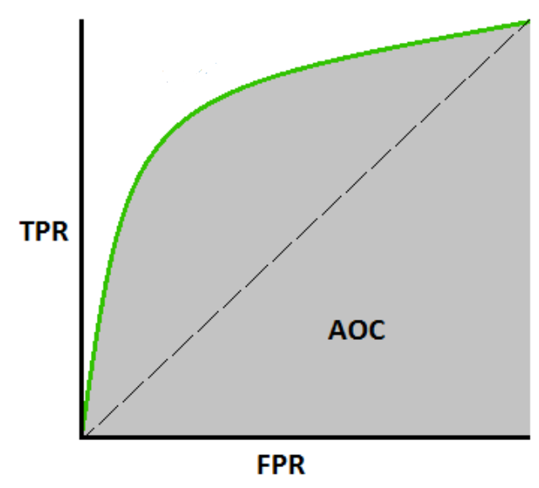
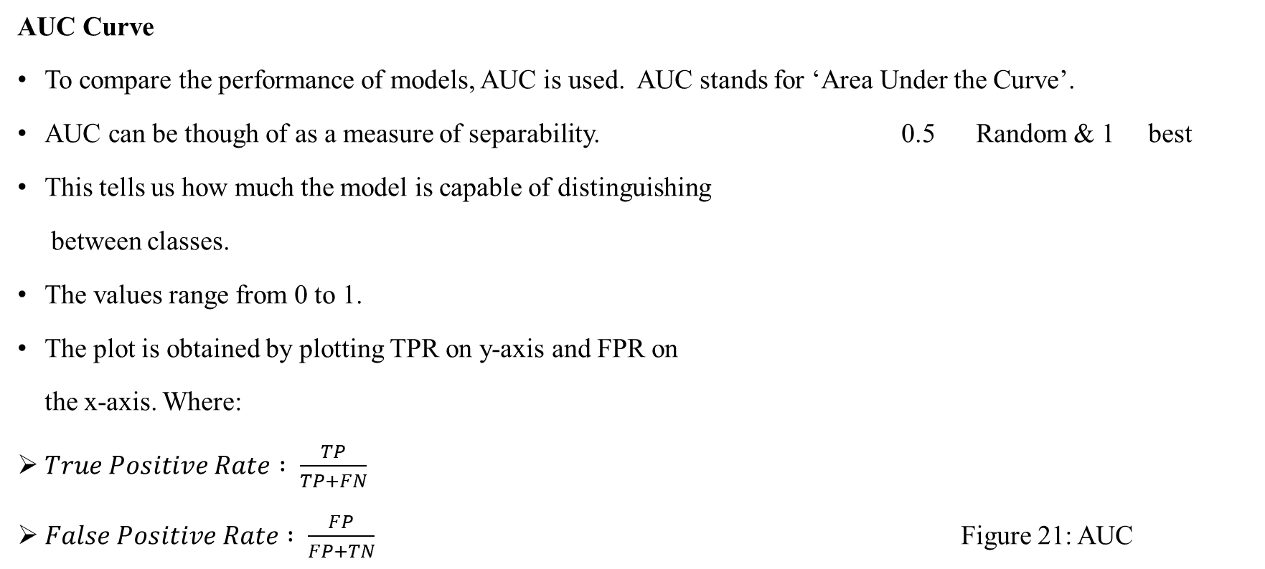
CLASSIFICATION
AUC Curve
To compare the performance of models, AUC is used. AUC stands for ‘Area Under the Curve’.
AUC can be though of as a measure of separability. 0.5 Random & 1 best
This tells us how much the model is capable of distinguishing
between classes.
The values range from 0 to 1.
The plot is obtained by plotting TPR on y-axis and FPR on
the x-axis. Where:
$True Positive Rate : \frac{TP}{TP+FN}$
$False Positive Rate : \frac{FP}{FP+TN}$ Figure 21: AUC

Slide 26
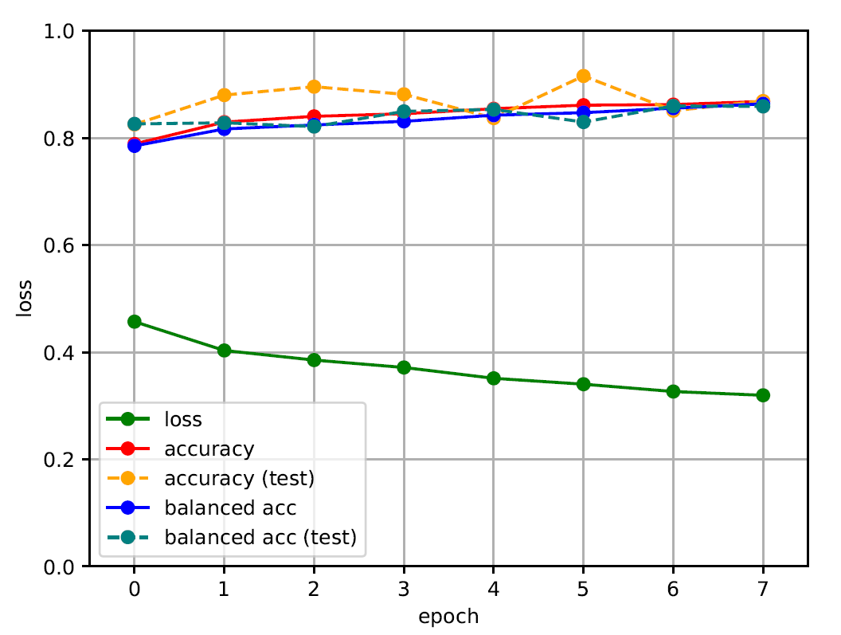
CLASSIFICATION
Classification Results
For training a test-train split of 80-20% was used.
Batch size was kept at 32 and the model was trained for 8 iterations.
Learning rate for CNN was kept as 10⁻⁴ while for linear layers it
was kept as 10⁻³.
Adam was used the optimizer and BCE as loss function.
Efficient Net B1 was able to achieve a balanced accuracy of
about 86%. Figure 22: Classification Results

Slide 27
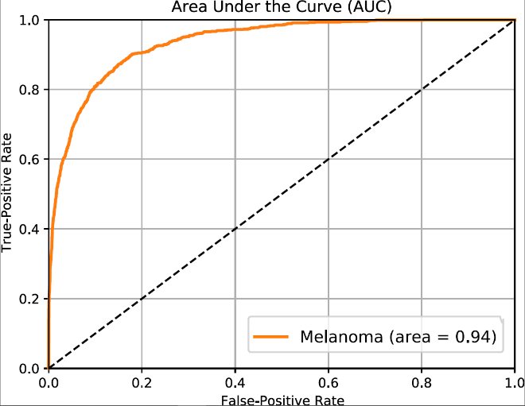
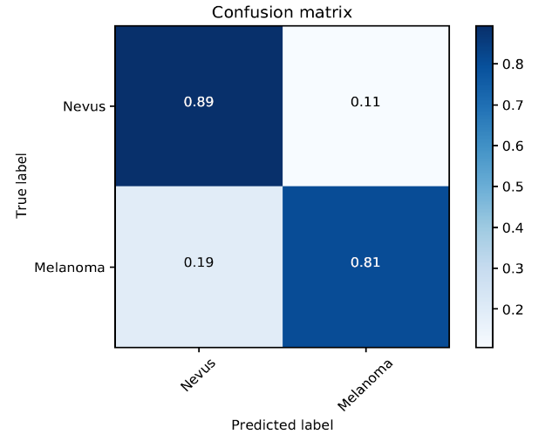
CLASSIFICATION
Classification Results
It achieves an AUC of 0.94. Figure 23: AUC
Test confusion matrix can be
found in figure 22. Figure 24: Test Confusion Matrix

Slide 28
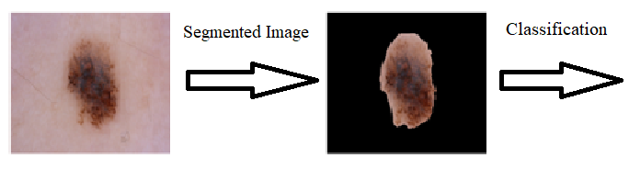
CLASSIFICATION+SEGMENTATION
Enhance Classification
Segmented data obtained from U-Net was used in order to enhance classification performance.
Methods experimented with are discussed in this section.
Method 1: Black Background
The output binary mask from U-Net is used to segment the input image to be processed for classification.
An example image can be found in figure 25.
Experiment results show that this method is not effective.
The training loss wasn’t decaying much initially therefore
learning rate decay had to be used. Figure 25: Black Background
The model could attain an AUC of 0.91 and balanced accuracy of about 83%.

Slide 29
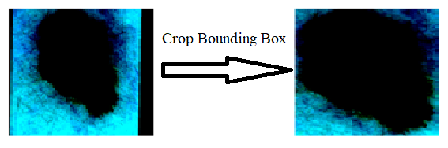
CLASSIFICATION+SEGMENTATION
Enhance Classification
Method 2: Bounding Box Approach
This method focuses on extracting just the region of mole from an image based on segmented data.
The mask predicted by the U-Net network is passed through an algorithm which gives us the 4 coordinates of
the points(Rectangle) around the mole.
This is used to crop the image and resize it back to scale.
Experimental results show that this method is not effective.
Training loss was not decaying initially, therefore learning Figure 26: Image crop on Bounding Box
rate decay had to be used here as well.
The model could attain an AUC of 0.91 and a balanced accuracy
of about 82%.

Slide 30
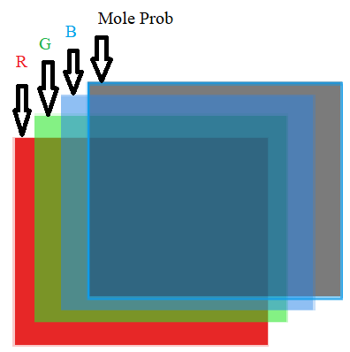
CLASSIFICATION+SEGMENTATION
Enhance Classification
Method 3: Integrate Mole Probability in Image
In this method we integrate the mole probability feature map(Output from U-Net) in the RGB image, essentially making it 4 channels.
But Efficient-net B1 was designed to take only 3 channel images as input and will not accept our new input.
To counter this problem an additional convolution filter was added into the existing convolution network.
The weights in the 4th filter were initialized with random weights.
While on the AUC front there does not seem to be many changes from original,
when we look at the false-negatives, much improvement can be seen.
Both, the Efficient-Net B1 and modified Efficient-Net B1 were run 8 times
and in all the runs the false–negative prediction is less for the modified version. Figure 27: New Input

Slide 31
CLASSIFICATION+SEGMENTATION
Enhance Classification
Modified efficient net B1 was able to achieve a balanced accuracy
of about 87% & AUC of 0.95.
Table listing all the runs and false negative predictions
of the 2 models associated can be found in Table 2.
On an average, in the 8 runs there is a reduction
in false negative prediction by about 38.7%.
Table 2: Test set False Negative Comparison
Trial | Original Architecture | Architecture with Mole Probability
1 | 0.16 | 0.12
2 | 0.16 | 0.14
3 | 0.15 | 0.10
4 | 0.15 | 0.13
5 | 0.23 | 0.10
6 | 0.17 | 0.08
7 | 0.19 | 0.13
8 | 0.26 | 0.10
Average | 0.1837 | 0.1125

Slide 32
FUTURE WORK
Future work of this thesis is:
Implementing different architectures:
Experimenting with other neural network architectures.
For example: Mask-RCNN.
Real time Implementation:
The final goal to create a complete software application which is an end-to-end detection package.
People can create accounts, click and upload pictures of spots they think are suspicious which will then be processed by our deep learning framework and return the results in minutes.
They can also keep track of the images they upload over time and the application can serve as a repository.
Since melanoma changes shape at a fast rate, any changes can be observed quickly.

Slide 33
Thank you!!
Questions?

